Slide 1






Stock Market Price prediction using Machine learning
Project Title
Team Members: CHARAN S
KARTHIK P
PAVAN P
REDDY AKASH B
Guide: SHILPA HARIRAJ
Disclaimer: The content is curated for educational purposes only.

Slide 2
OUTLINE
Stock Market Price prediction using Machine learning
Abstract
Problem Statement
Aims, Objective & Proposed System/Solution
System Design/Architecture
System Development Approach (Technology Used)
Algorithm & Deployment
Conclusion
Future Scope
References
Video of the Project

Slide 3
Abstract
Stock Market Price prediction using Machine learning
Stock price prediction has always been a challenging task due to the complex and dynamic nature of financial markets. With the advent of machine learning techniques, there has been a growing interest in developing models that can leverage historical data to make accurate predictions. This research proposes an integrated approach for stock price prediction, combining various machine learning algorithms and feature engineering strategies.

Slide 4
Problem Statement The problem addressed in this research is the inherent difficulty in accurately predicting stock prices, given the complex and dynamic nature of financial markets. Traditional methods often fall short in capturing the multitude of factors influencing stock price movements.
Stock Market Price prediction using Machine learning

Slide 5
Aim and Objective
Stock Market Price prediction using Machine learning
Aim :
Our aim is to develop predictive model that accurately predicts stock market prices
Objective:
Collect and analyze relevant data.
Develop and implement machine learning models for stock price prediction.
The research aims to evaluate and compare the performance of various machine learning algorithms & predict the stocks

Slide 6
Stock Market Price prediction using Machine learning
Proposed Solution
To address the challenge of prediction stock market price ,A comprehensive solution involving data preparation ,feature engineering ,model selection, training , and evaluation is proposed

Slide 7
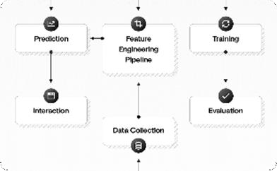

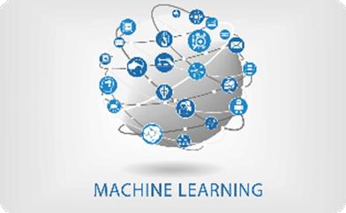
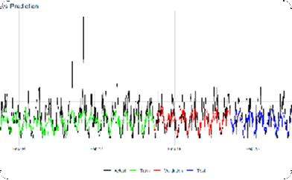
Stock Market Price prediction using Machine learning
System Architecture
Overall Architecture
Our system follows a modular architecture, consisting of data collection, preprocessing, model training, and prediction modules.
Data Collection Module
We gather relevant stock data from NSE and Y a h o o
F i n a n c e other sources to build our dataset.
Prediction Module
Our system provides real-time attrition predictions, empowering users to take proactive measures to predict closing stocks
Model Training Module Using various machine learning algorithms, we train the models on availability of Stock for analyze to understand patterns and predict.

Slide 8
System Deployment Approach
Stock Market Price prediction using Machine learning
1.Technology Stack
- Pandas & Numpy for data cleaning & data preprocessing.
Scikit-learn for machine learning algorithms.
Dash used to create many analytical web applications.
Keras for DL, used to make the implementation of neural networks.
Plotly for data visualization.
2. Development Methodology
Our team follows an agile development approach, ensuring continuous collaboration, flexibility, and iterative improvements throughout the project.

Slide 9
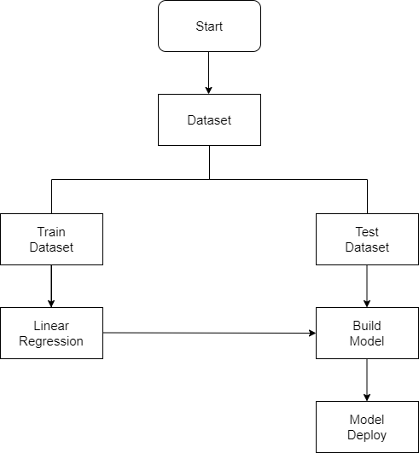
Stock Market Price prediction using Machine learning
Algorithm & Deployment
Machine Learning Algorithms:
We employ a combination of algorithms Sci-kit learn, Keras, plotly & LSTM to build our attrition prediction models
Model Deployment:
The trained models are deployed using Dash, allowing organizations to seamlessly integrate the attrition prediction system into their existing infrastructure
LSTM Model

Slide 10
Conclusion
Stock Market Price prediction using Machine learning
In conclusion, the implementation of a stock price prediction model using machine learning techniques represents a comprehensive and dynamic approach to understanding and forecasting financial markets. Through meticulous data collection, preprocessing, and feature engineering, we have harnessed historical stock data's latent patterns and incorporated relevant indicators, including technical and sentiment-based features. The chosen machine learning algorithms like LSTM Model, were trained and evaluated, providing insights into their predictive capabilities. The incorporation of advanced feature scaling, hyperparameter tuning, and optional feature importance analysis further refined model performance. The models were successfully applied to new data for real-time predictions, and visualizations were employed to enhance result interpretation.

Slide 11
Future Scope
Stock Market Price prediction using Machine learning
For advancing stock prediction using machine learning, consider exploring deep learning architectures, including Transformer-based models and attention mechanisms, to better capture intricate temporal dependencies and non-linear patterns in stock price data. Additionally, broaden the scope by integrating alternative data sources such as satellite imagery, social media sentiment, and economic indicators to enrich the feature set, enhancing the overall robustness of stock prediction models.

Slide 12
Reference
Stock Market Price prediction using Machine learning
Stock price prediction using machine learning by Yixin Guo.
Machine learning approaches in stock price prediction by Paya Soni, Yogya Tewari, Deepa Krishnan.
Stock Price prediction using Machine Learning Techniques by Nusrat Rouf Masjid Bashir Malik, Tasleem Arif .

Slide 13
Thank you!
Stock Market Price prediction using Machine learning

